Slide 1
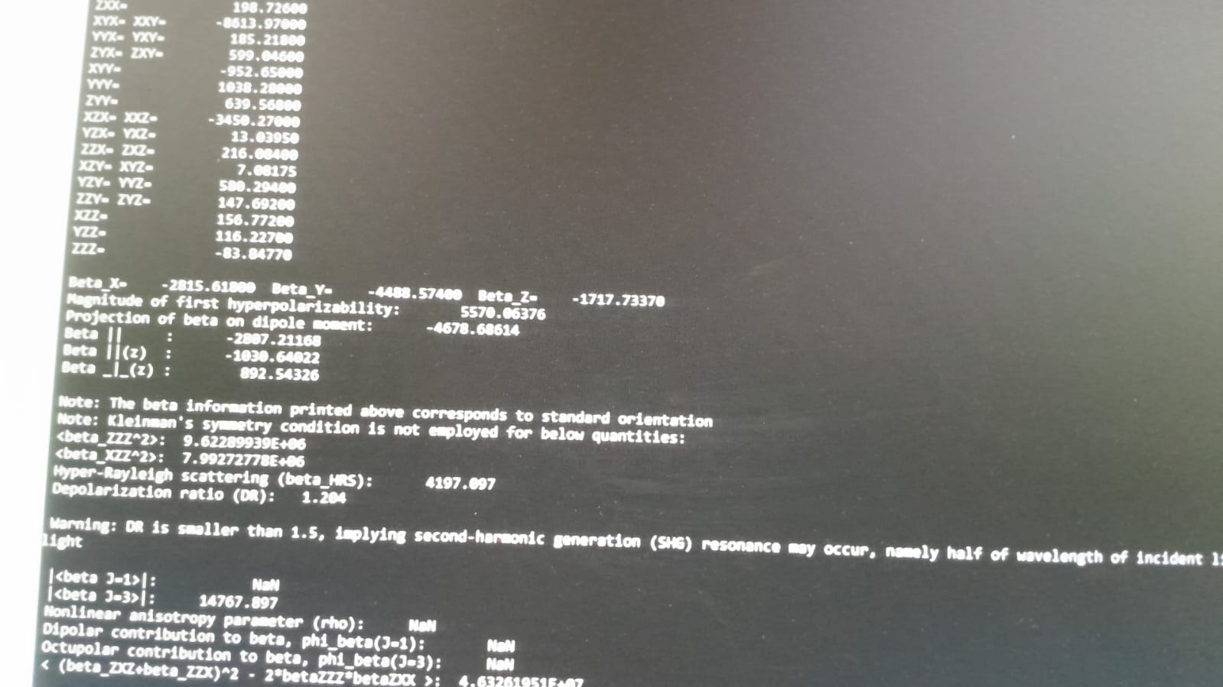
While doing analysis of betaHRS
I got the result as shown inimagewhere someparametervalues are shown as NaN.
Can any one help in finding these values ?
Thankyou.

